Slide 1



Garbage Classification

Slide 2


Learning Objectives
Understand how to preprocess image datasets for classification.
Learn and implement Convolutional Neural Networks (CNNs).
Use pretrained models (MobileNetV2) for real-world classification.
Evaluate model performance using accuracy and loss metrics.
Build a predictive model that classifies 6 types of garbage images
GOAL
Source :
www.freepik.com/

Slide 3
Tools and Technology used
🧠 Model: MobileNetV2 (Transfer Learning)
🧪 Framework: TensorFlow + Keras
💻 Platform: Google Colab
📊 Visualization: Matplotlib
📦 Dataset Access: Kaggle API

Slide 4
Methodology
1. Dataset Collection from Kaggle
2. Data Preprocessing & Folder Organization
3. Image Augmentation using ImageDataGenerator
4. Training with MobileNetV2
5. Evaluation (Accuracy/Loss graphs)
6. Model Saving & Image Prediction

Slide 5
Problem Statement:
Waste is often not sorted correctly, making recycling difficult. There is a need for an automated system to classify garbage accurately for better waste management and environmental protection.

Slide 6
Solution:
I developed a deep learning model using MobileNetV2 to automatically classify garbage into six categories: plastic, paper, metal, glass, cardboard, and trash.The model was trained on real-world garbage images with data augmentation and achieved high accuracy.This solution can assist in automated waste sorting systems to improve recycling efficiency and reduce manual effort.

Slide 7
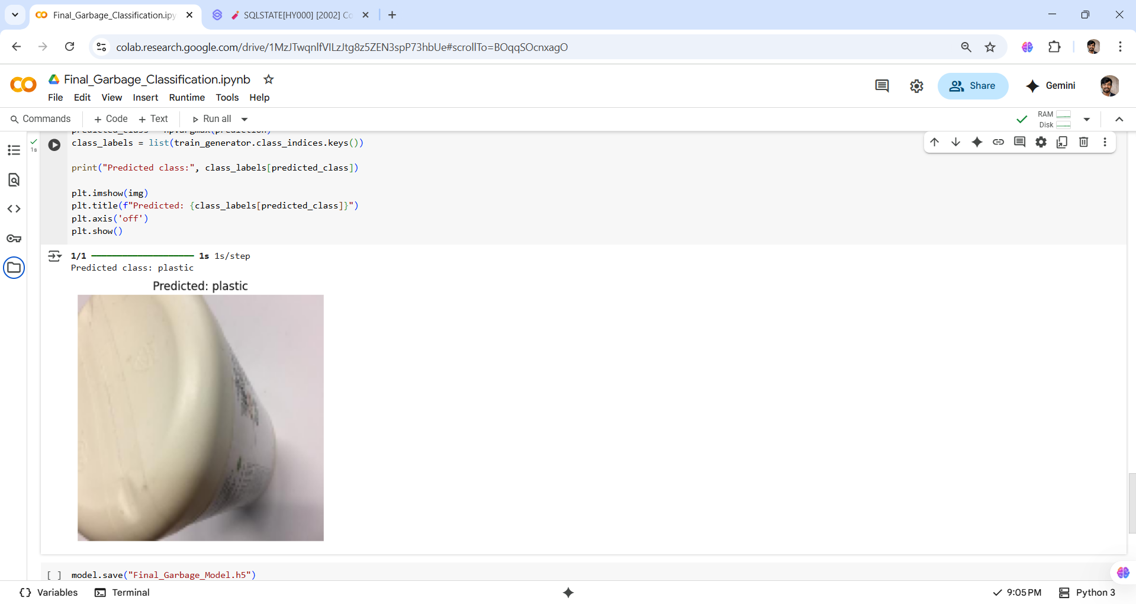
Screenshot of Output:

Slide 8

Conclusion:
The garbage classification model built using MobileNetV2 achieved high accuracy with limited data.
It successfully classifies waste into six categories and can be integrated into smart waste management systems.
Through this project, we gained hands-on experience in data preprocessing, model training, evaluation, and real-world prediction using deep learning.

